Slide 1
Moving to 3D lessons with NGSS
Christine O’Shea

Slide 2
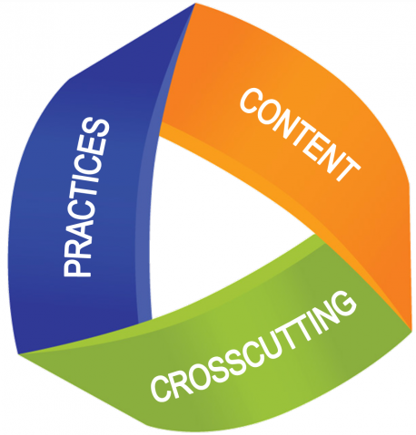
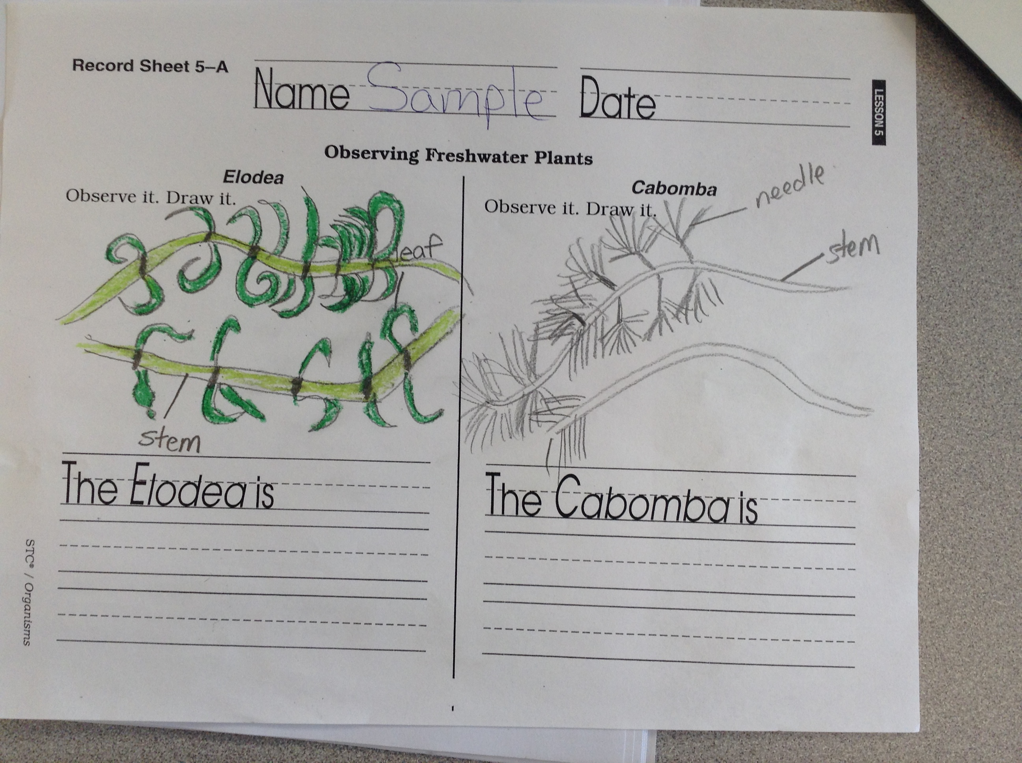
1 Dimensional teaching
Using the science kit to teach the standards
Worksheets with labeling but no function in life science, just description for different types of plants/animals through observation.
Teacher lecture on what plants/animals need and the function of the parts.

Slide 3
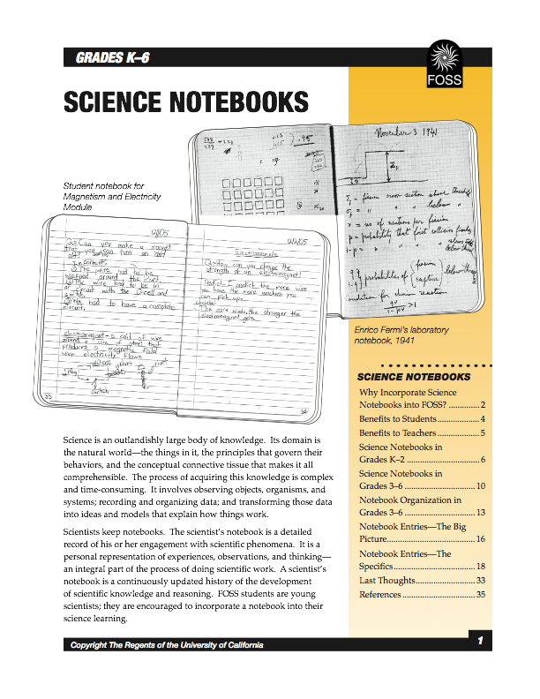
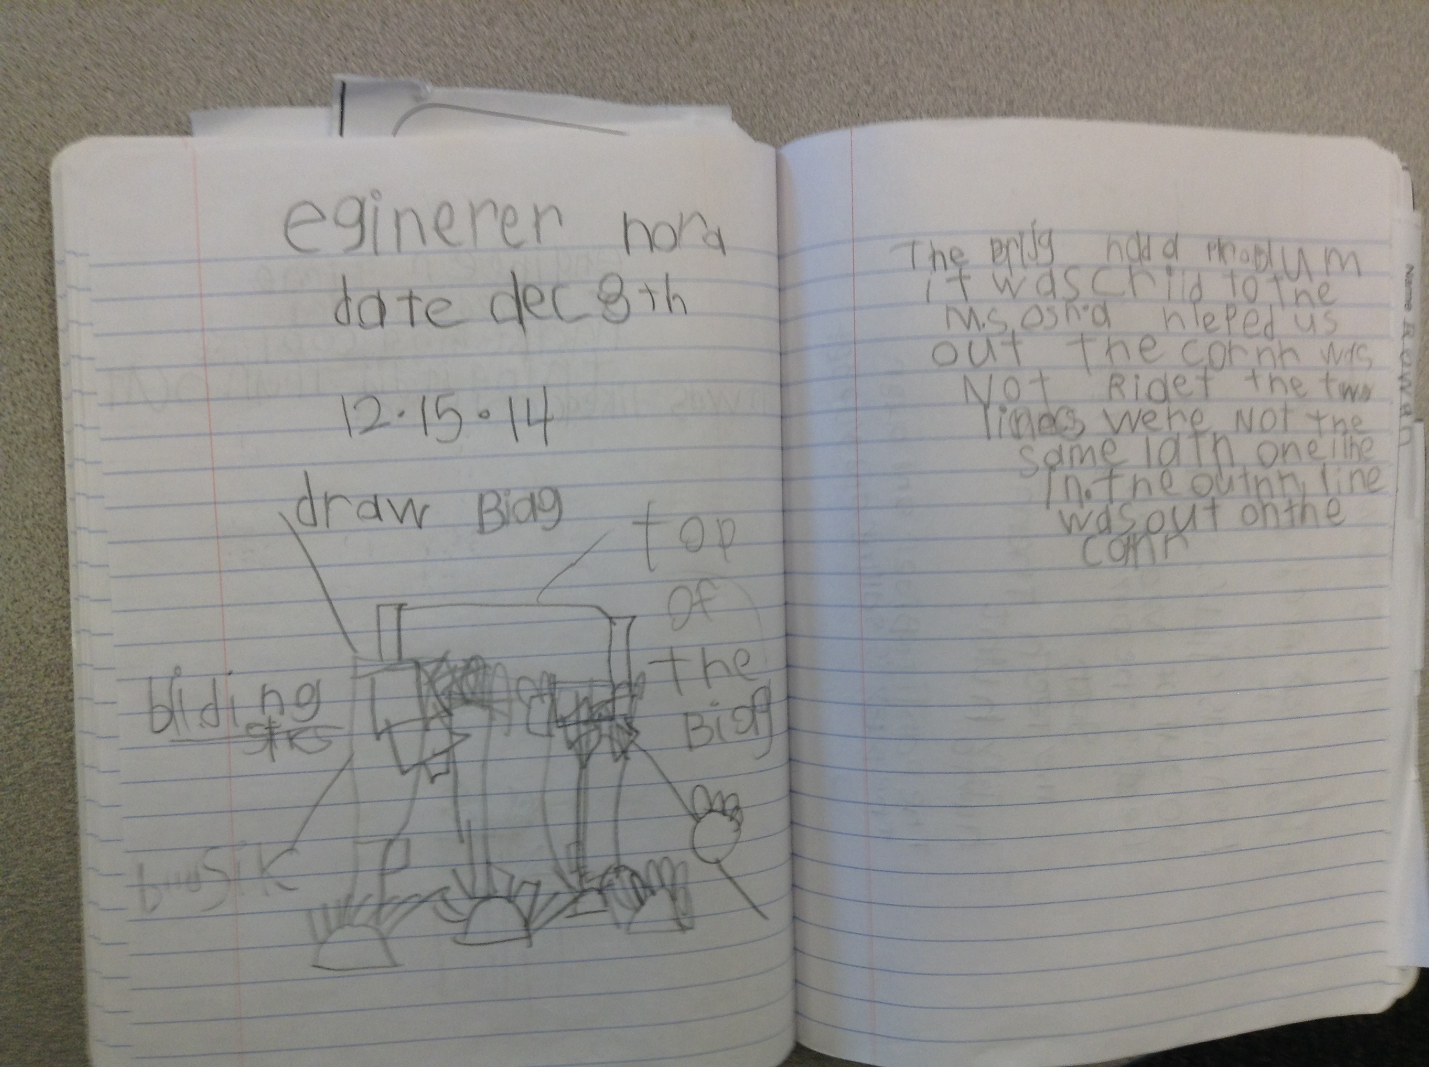
Writing in Science helps move to 3D
Science notebooks
Science practices introduced
I start with Asking Questions and Defining Problems - what is a scientist lesson/engineering challenges
KWL in notebooks and class

Slide 4
3D science
Plant/Animal observations and comparisons of how parts help them survive and grow in notebooks. Labeling plant diagram with parts and their functions. - questioning, obtaining information, models
celery and dye to see how plant uses water - ccc’s structure and function, patterns, system models, constructing explanation
Planning and carrying out an investigation- creating 4 experiments to test for 1 variable. Scaffold students about plants needs by eliminating one thing- water, dirt, air, light. Students record observations over time, making predictions and then recording results in notebook. Evidence of what happened.

Slide 5
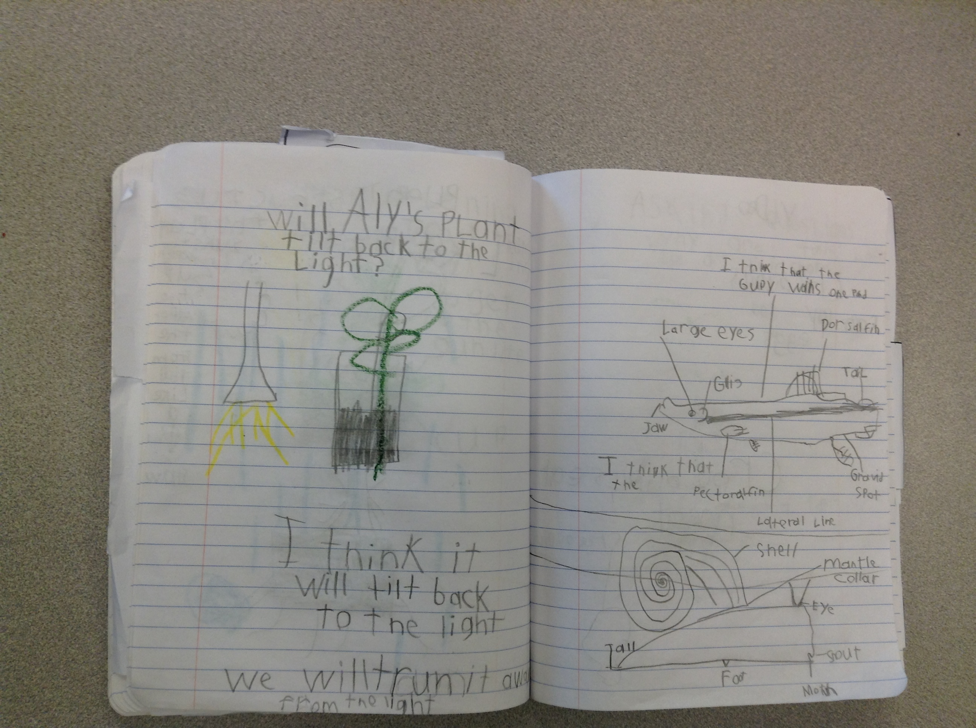
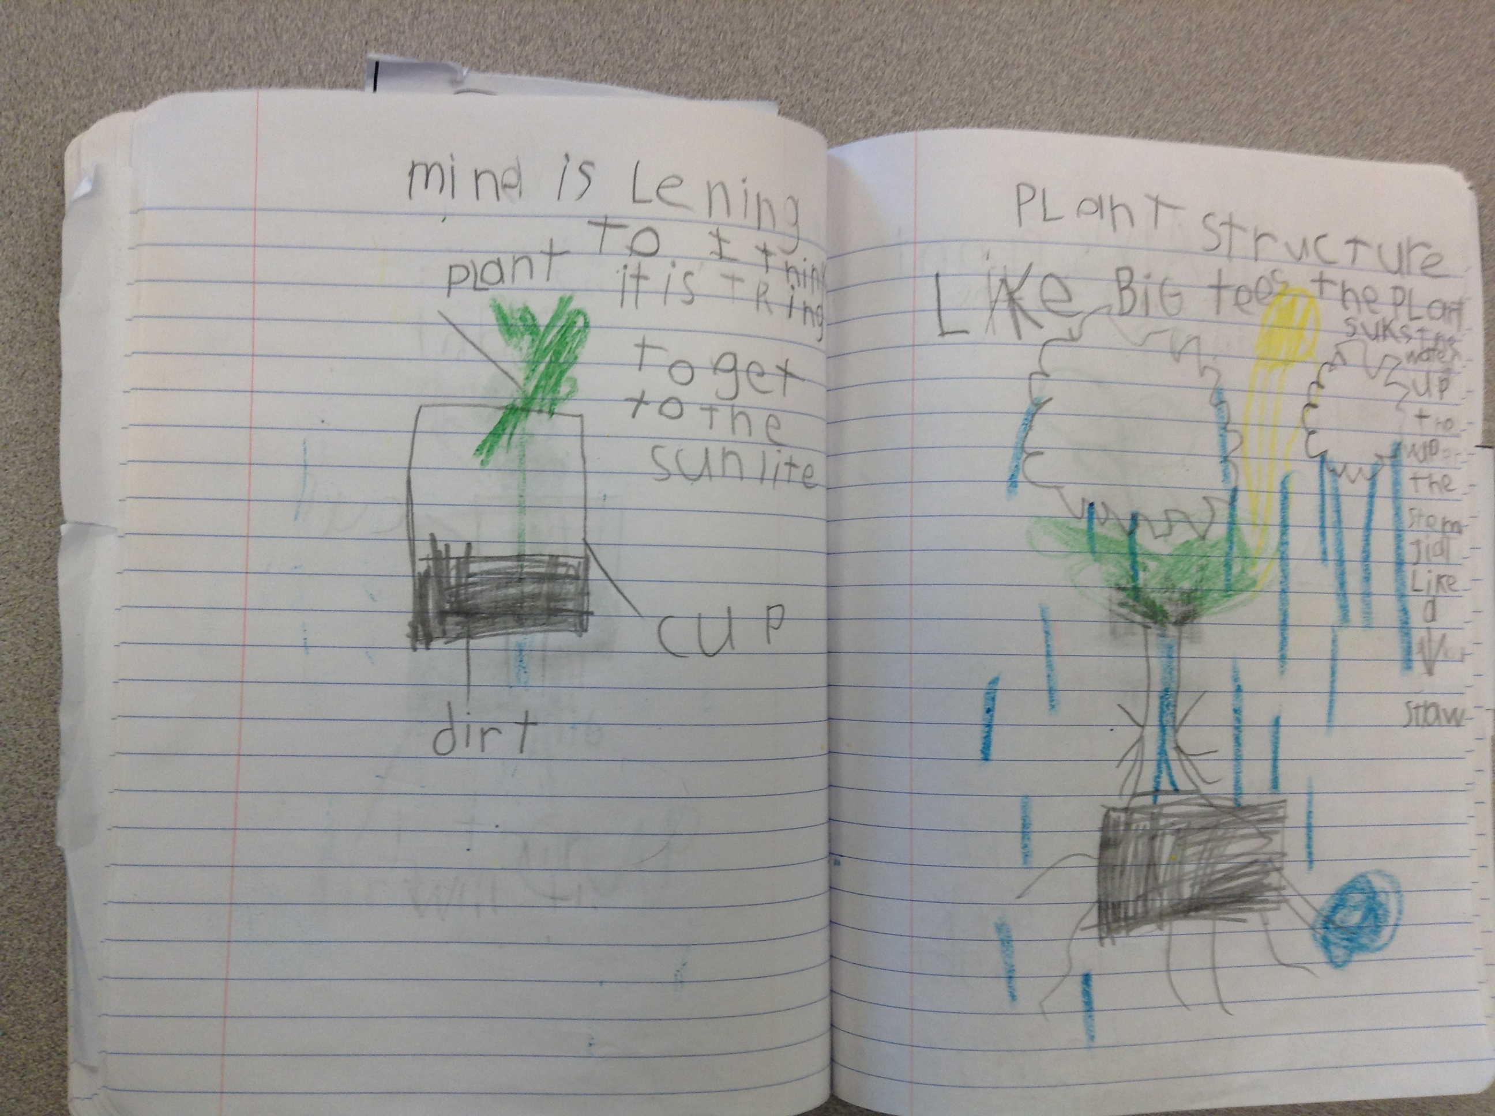
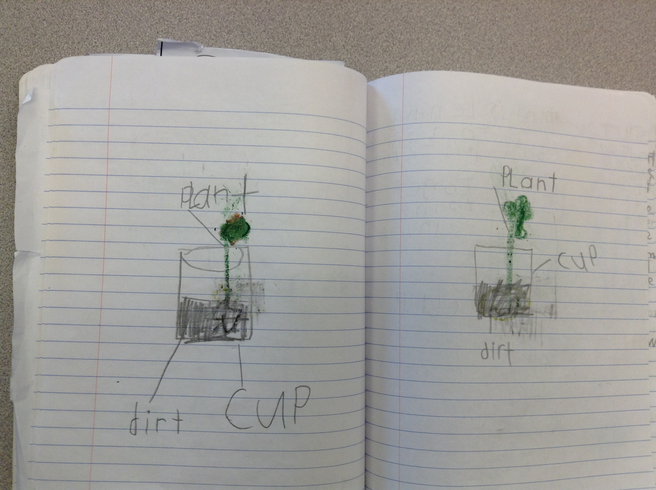
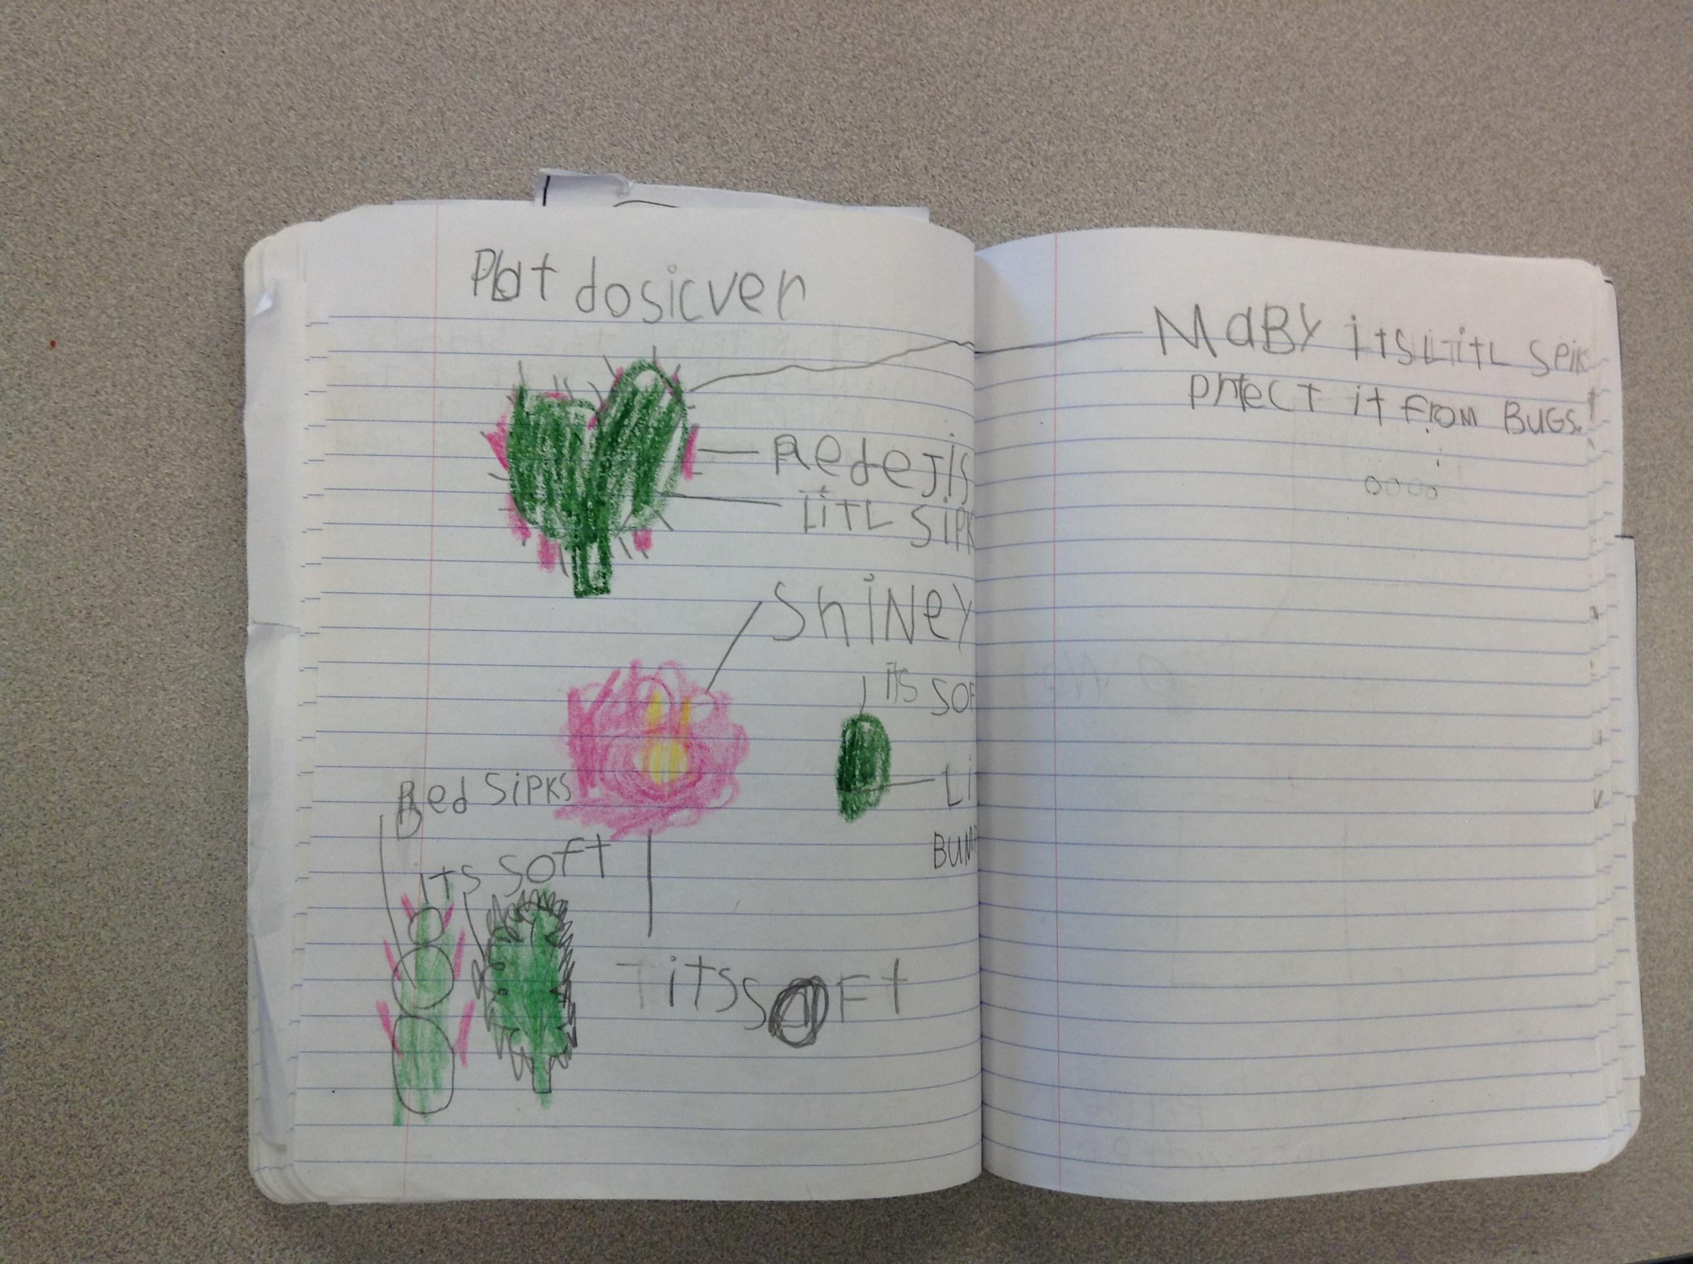
Student notebooks

Slide 6
Essential questions drive instruction
How do organisms use their external parts to help them survive?
What limitations does the organisms’ parts present?
How do plants and animals respond to environmental inputs to help them survive?
How do animal parents/offspring engage in behaviors that help them survive?
How are animal/plant adults/offspring alike or different?
students write these questions in notebook to answer.

Slide 7
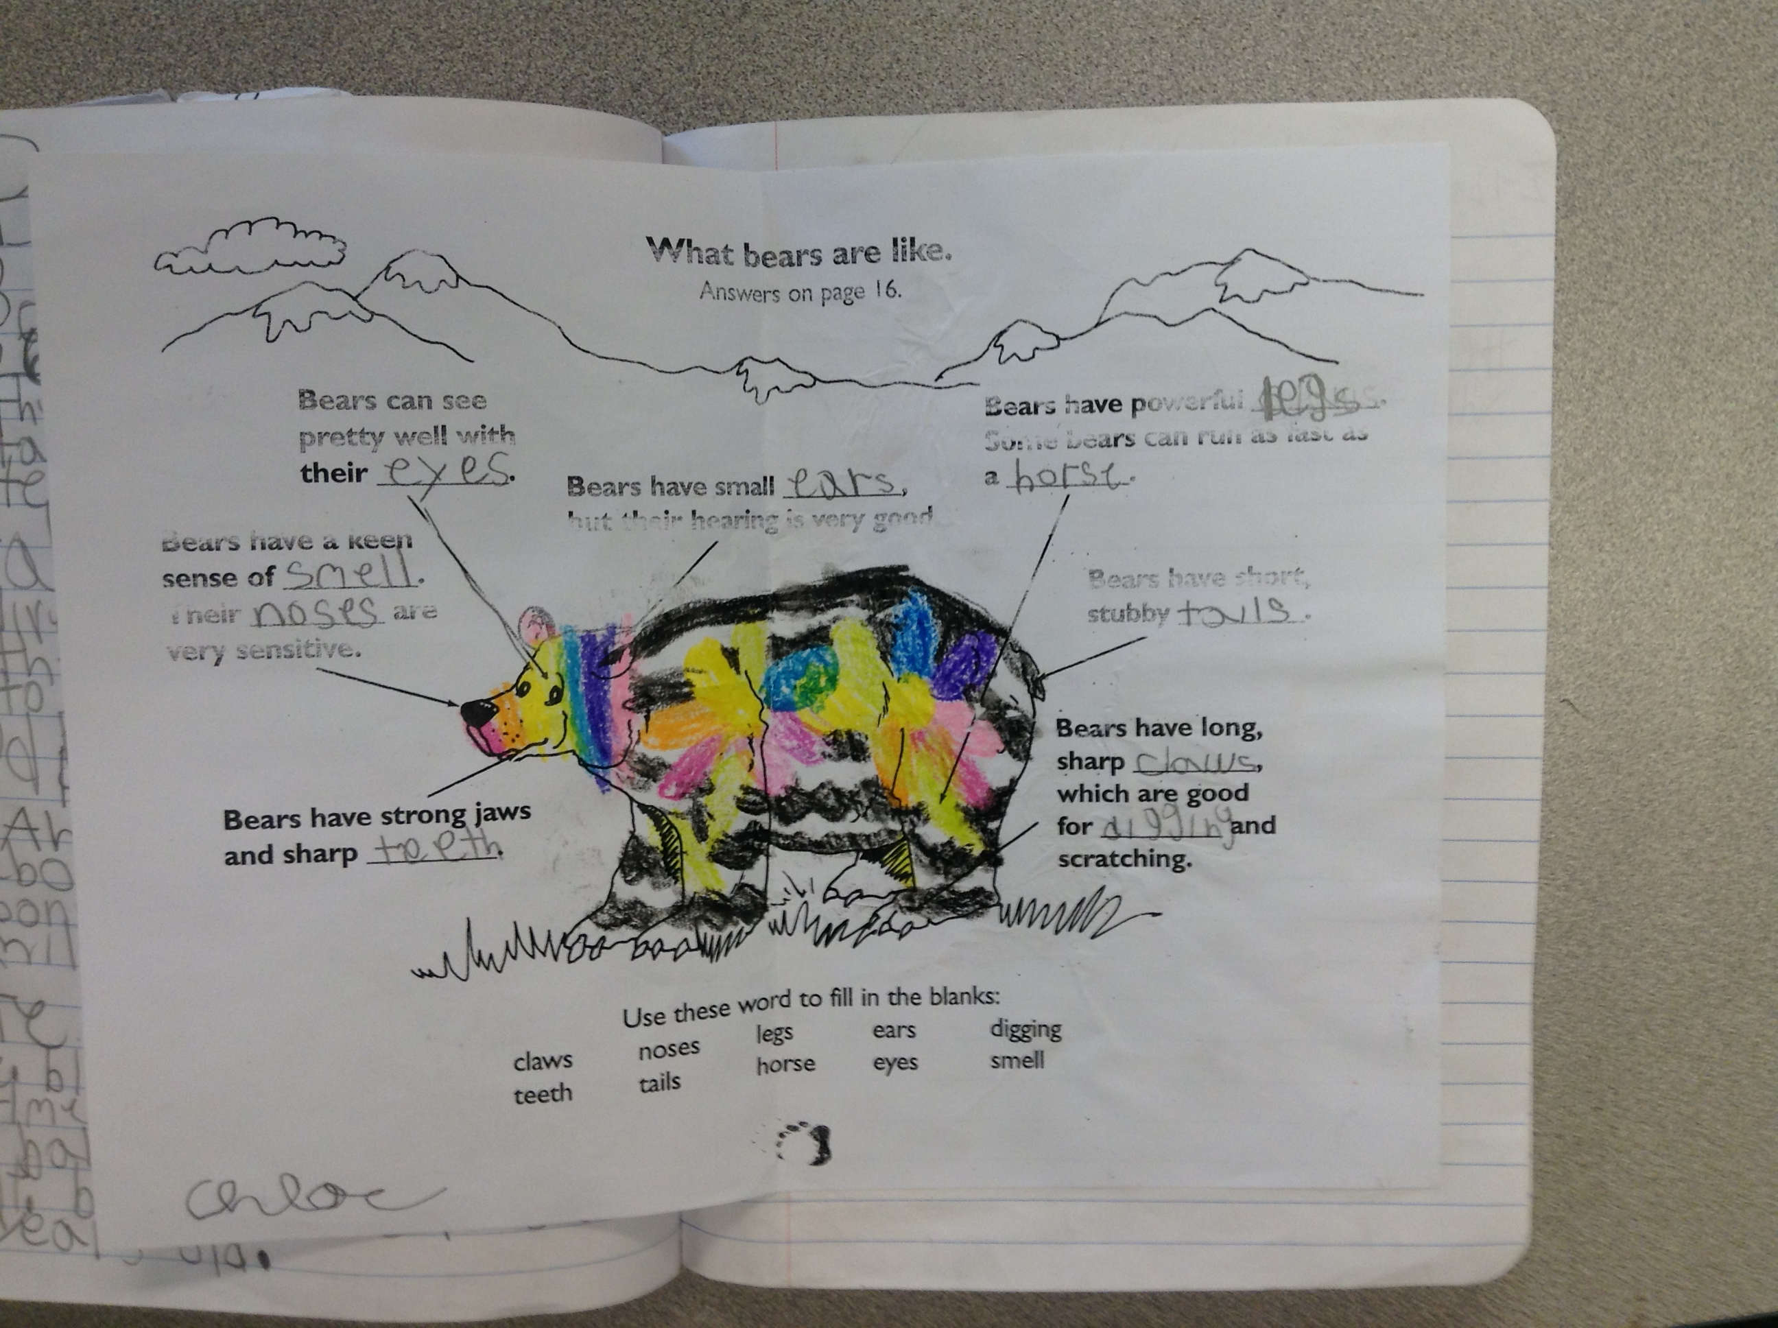
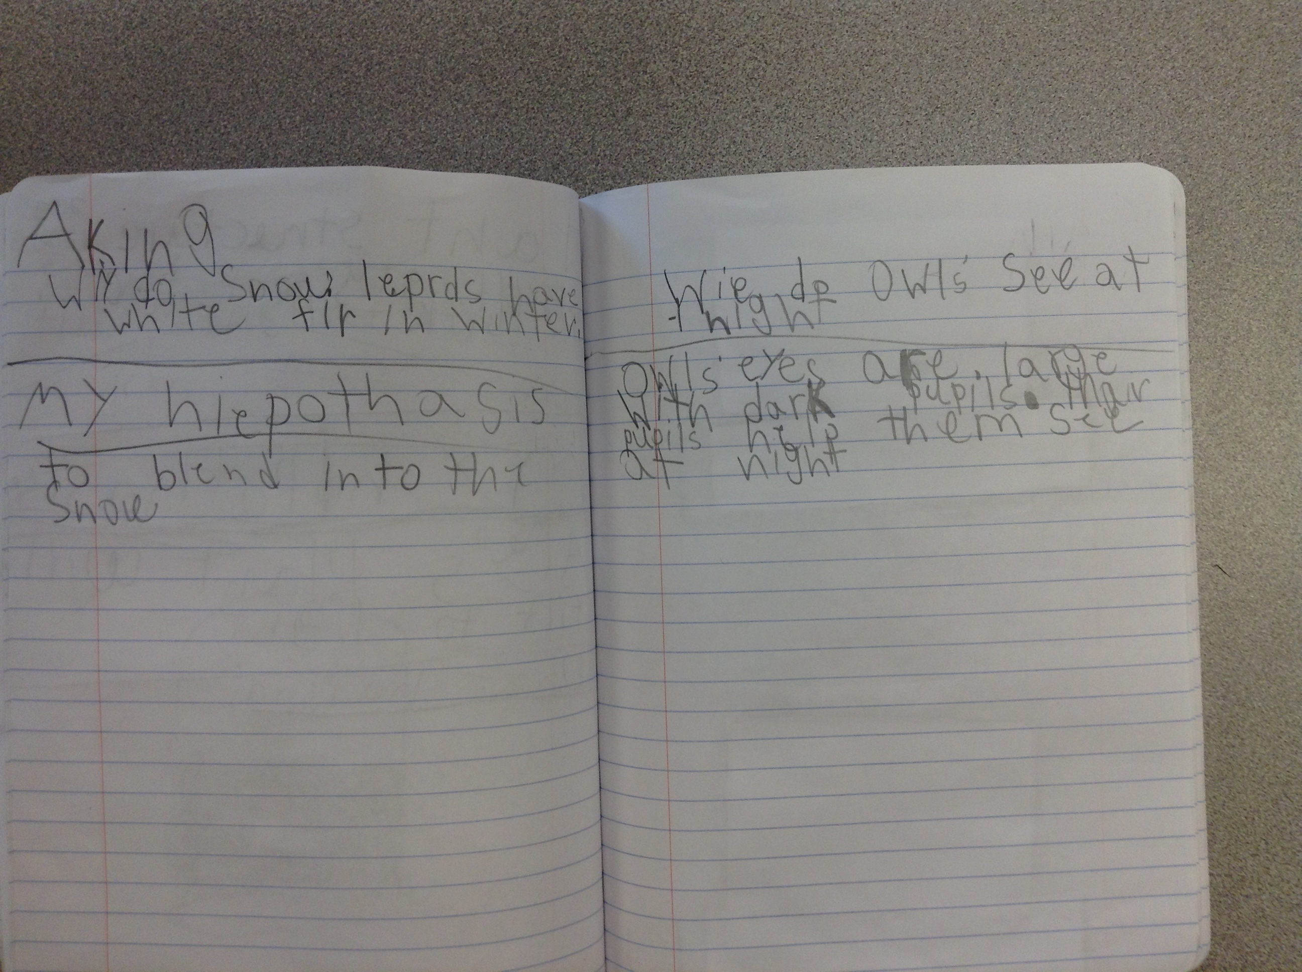
Practices and cross-cutting concepts deepen learning
How do organisms use their external parts to help them survive?
What limitations does the organisms’ parts present?
CCC = Structure and Function
Practices = Asking questions, obtaining, evaluating and communicating information, models- using media- books, web, video for information (ex. blubber model, claw)

Slide 8
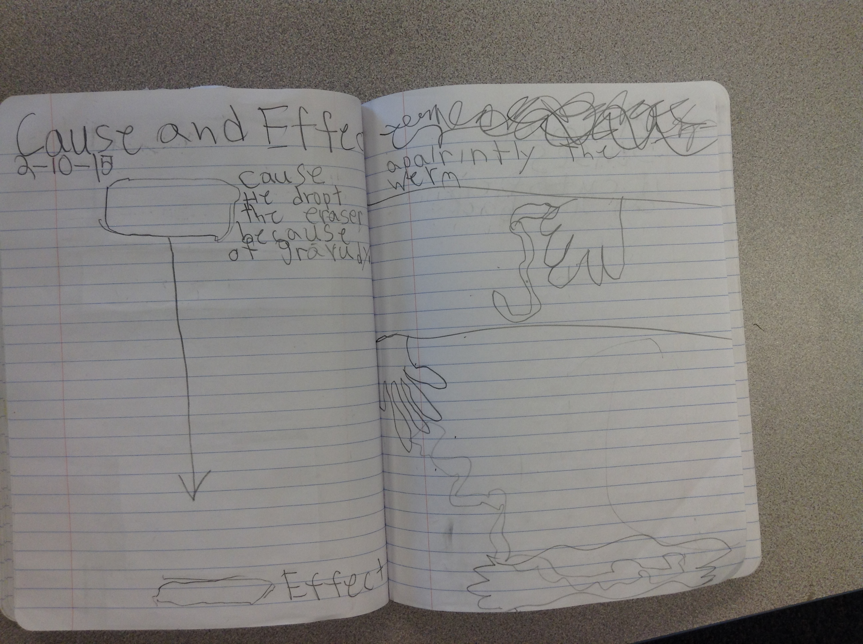
Practices and cross-cutting concepts deepen learning
How do plants and animals respond to environmental inputs to help them survive?
CCC = Cause & Effect - Practice: Obtaining, evaluating and communicating - worm activity stimulus response, - animal using their senses-
I use combination of media- books, web sites, video to show students this.

Slide 9
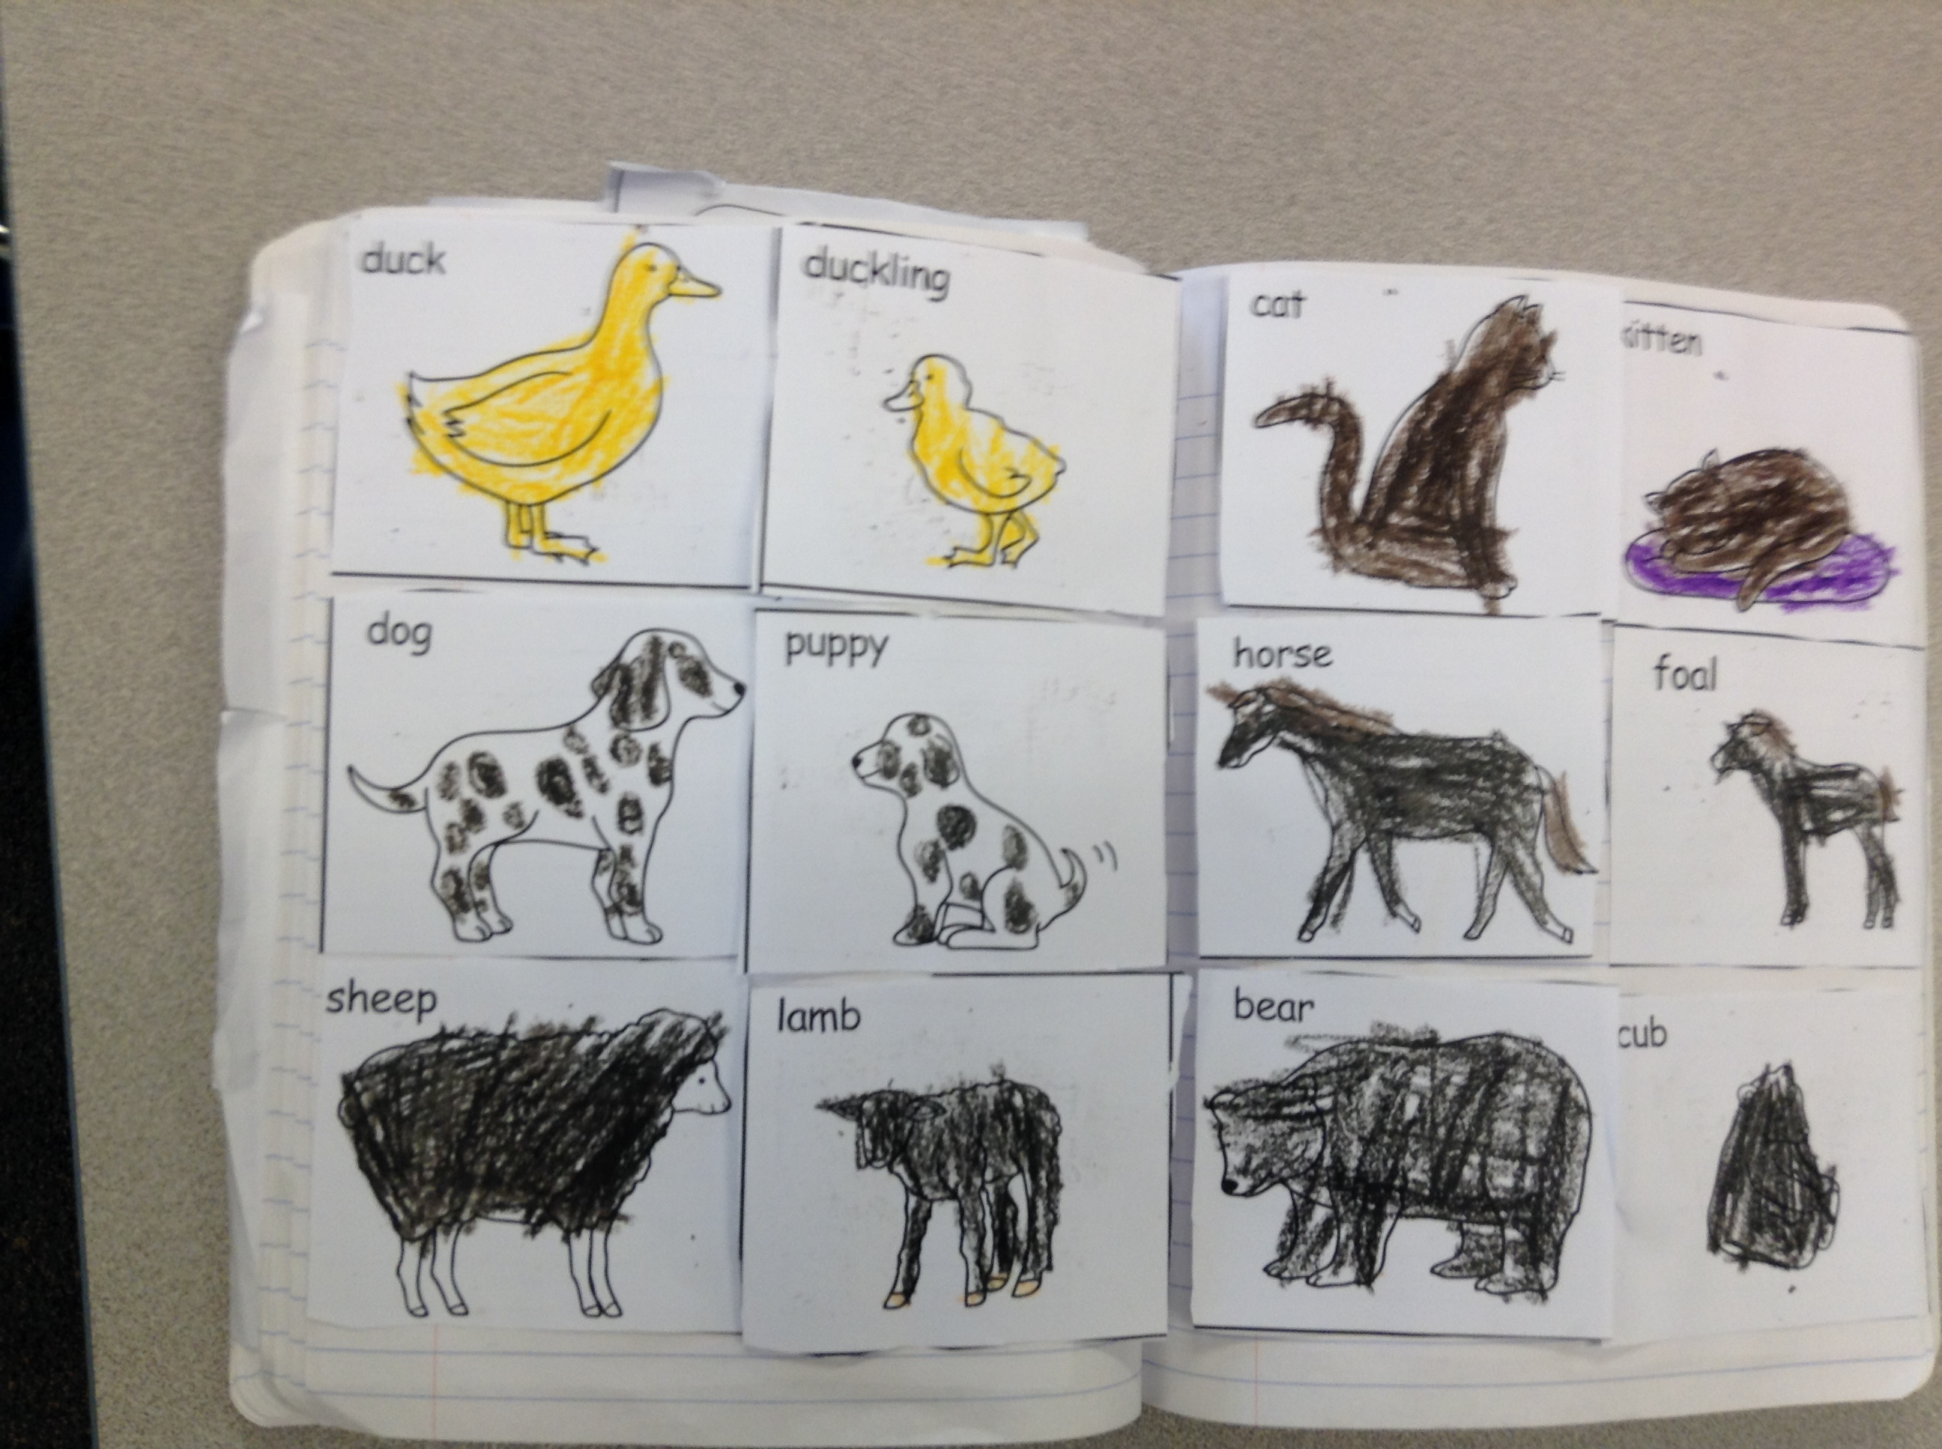
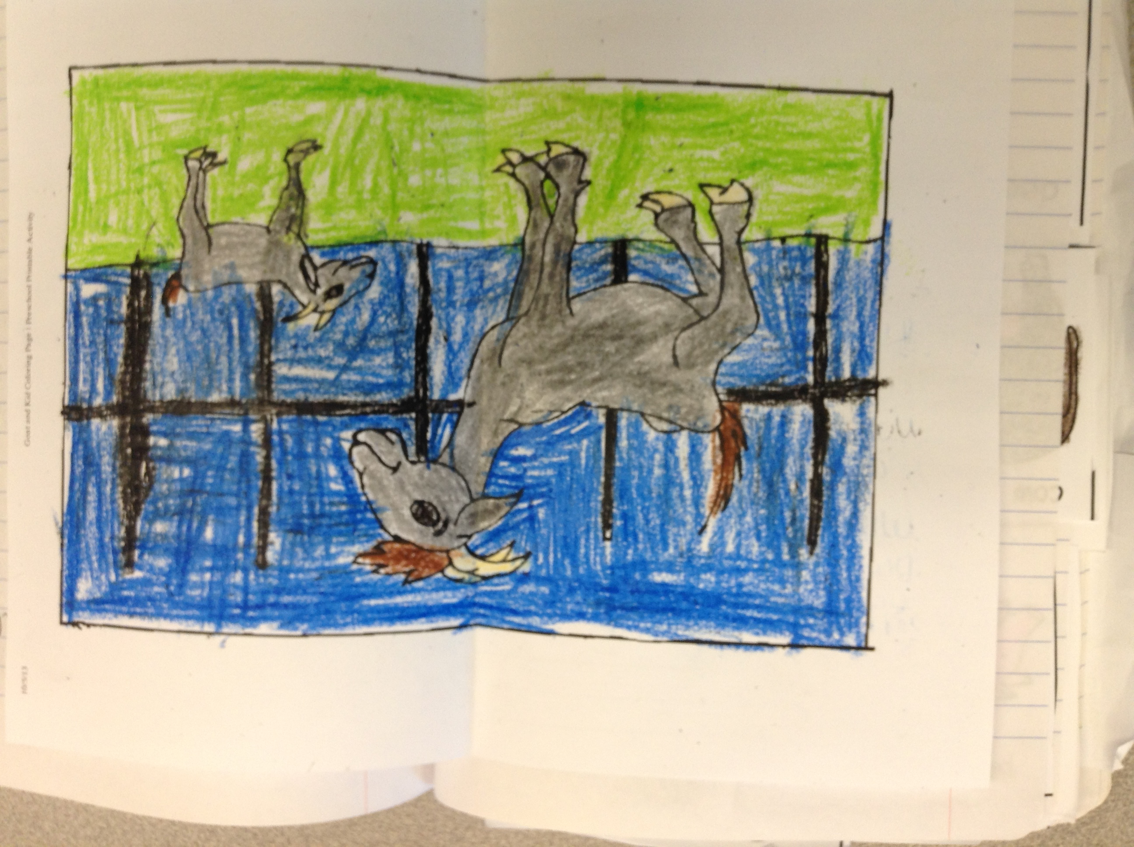
Practices and cross-cutting concepts deepen learning
How do animal parents/offspring engage in behaviors that help them survive?
How are animal/plant adults/offspring alike or different?
Obtaining, evaluating and communicating, constructing explanations and designing solutions, CCC Structure/function- matching cards animal babies, observing through animal videos, books, web research

Slide 10
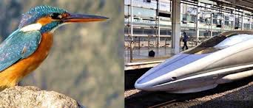
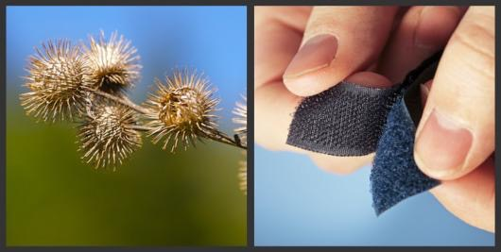
Performance expectations & 3D
3D leads students to be able to …..
students design a solution to a human problem by applying what they know about plants and animals.

